Slide 1
#blacklivesmatter

Slide 2
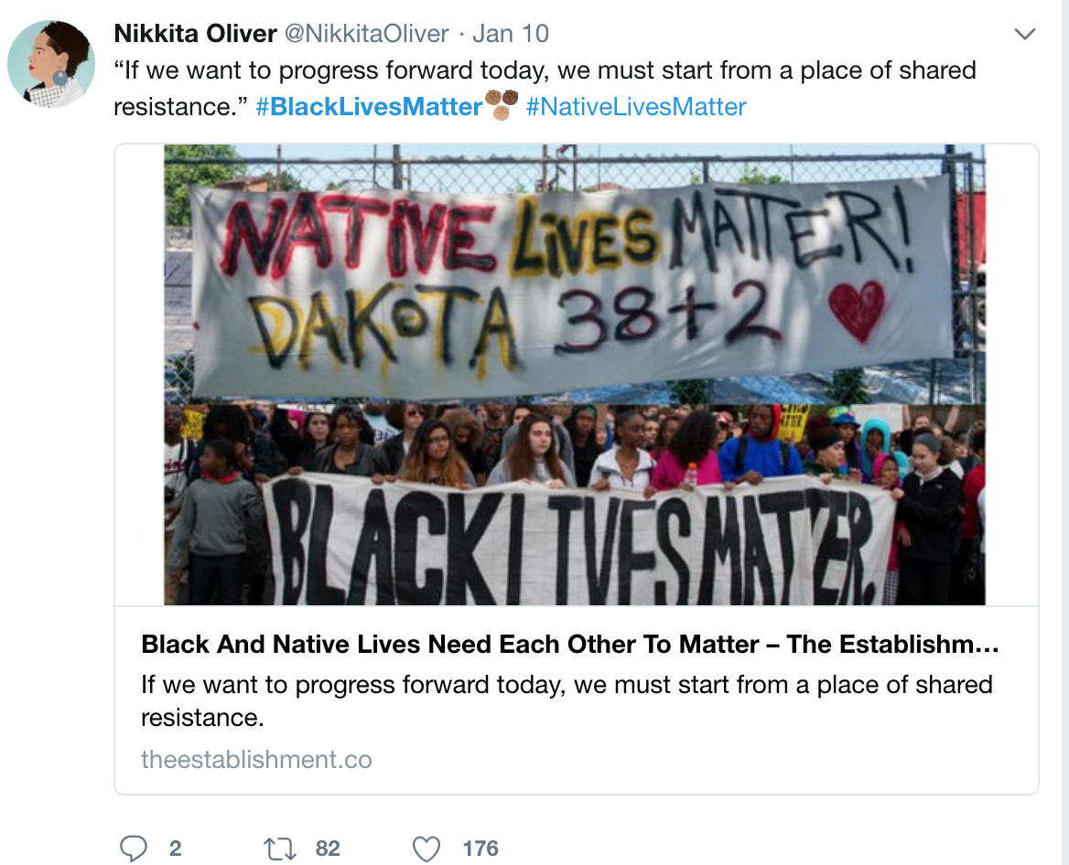

Slide 3
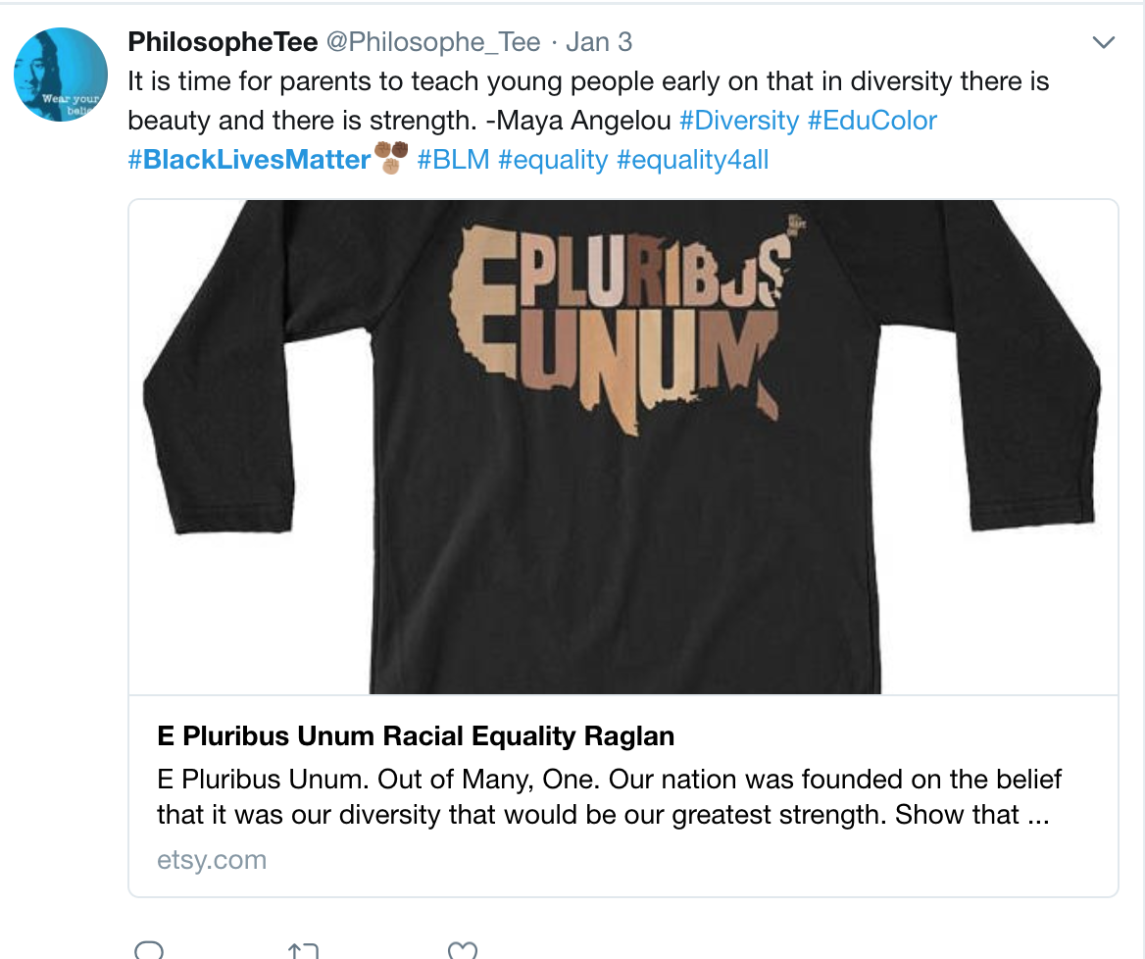

Slide 6
