Slide 1
#myasianamericanstory

Slide 2
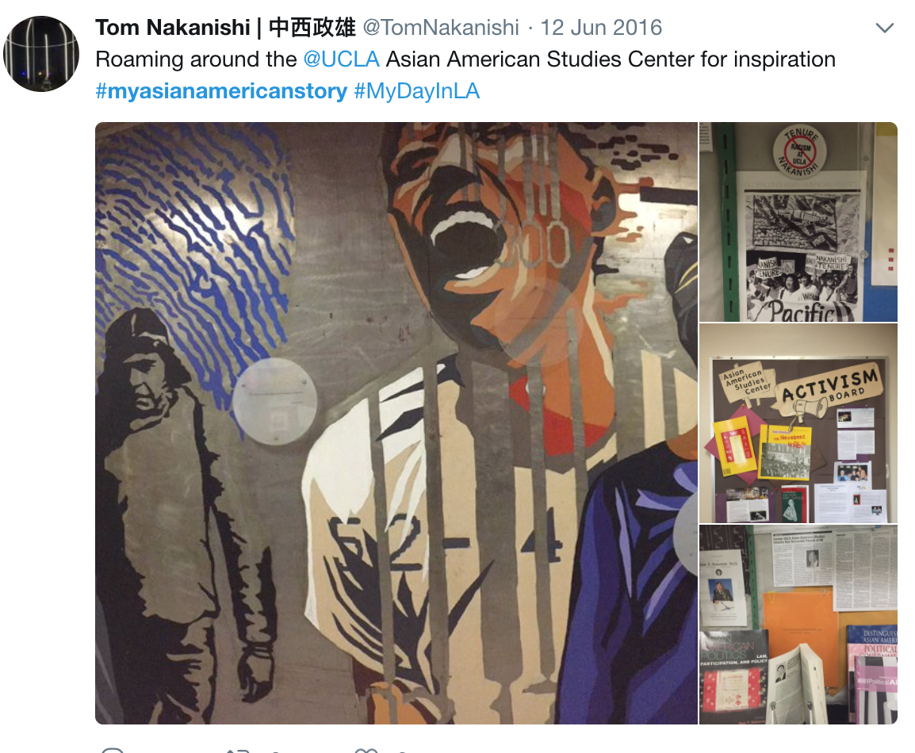

Slide 3
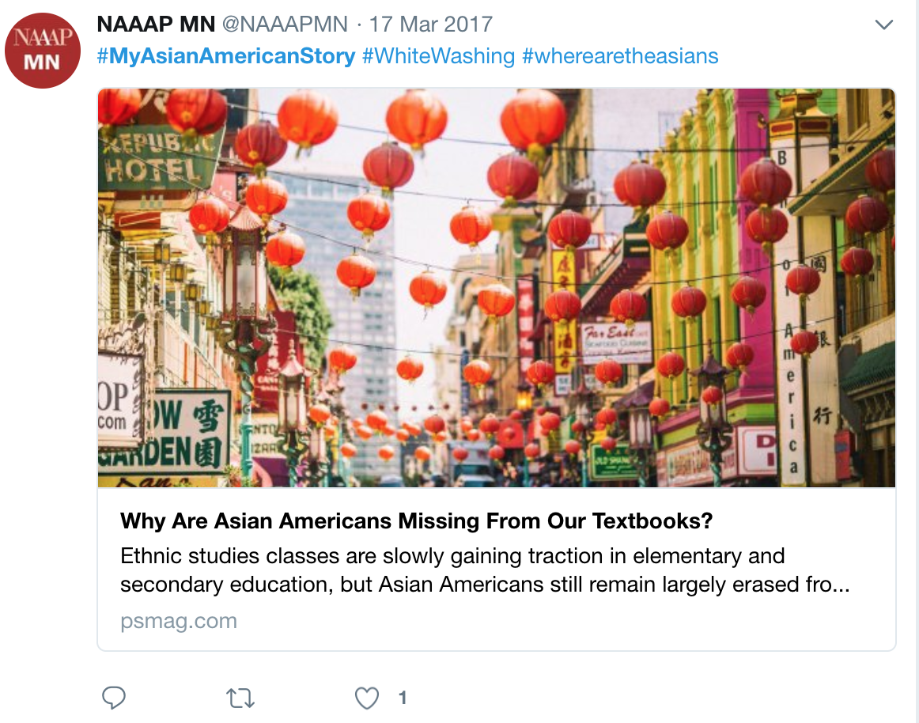

Slide 6
